Slide 1

Department of Computer Science & Engineering
Smart Ticket System for Metro Train Services
Subhash R | Sagar G U | Nihal R Gowda | Srihari k
1BG19CS107 | 1BG19CS088 | 1BG19CS065 | 1BG19CS104
Internal Guide:
Professor Dr. Jalaja G
Dept. of CSE, BNMIT

Slide 2
Problem Statement
To build a smart ticket system for metro train services using image recognition and artificial intelligence models.
To build a reliable verification and identification using biometric method for metro train commuters.

Slide 3
Introduction
Today, everything in the world is smart and digitalized. Many advances have been made in the transportation sector. Public transportation in India has always been an area where such new advances have turned their faces out.
There has been a significant increase in ridership in Metro train services.
Year | Ridership (in millions) | Average daily ridership(in millions)
2017-2018 | 702.95 | 1.93
2018-2019 | 801.70 | 2.20
2019-2020 | 870.91 | 2.39
2020-2021 | 946.95 | 2.59
2021-2022 | 1001.65 | 2.76

Slide 4


Contd…
In the past few years, face recognition owned significant consideration and appreciated as one of the most promising applications in the field of image analysis.
Face recognition is a type of biometric application that can identify individual in a digital image by analysing and comparing patterns.

Slide 5
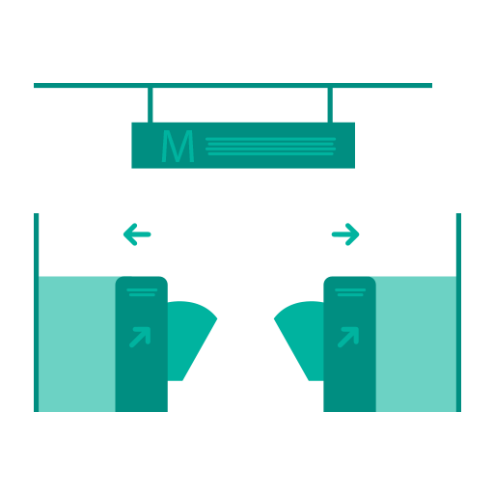
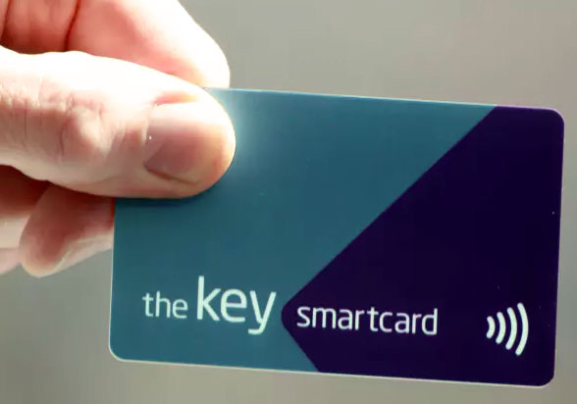

Existing System
The existing System includes two modes of tickets:
Card based system is used by daily commuters as it is a personalized mode of ticket.
Coin based system is only for a single time use.
These tickets are to be flashed at the AFC gates for check in and check out.

Slide 6
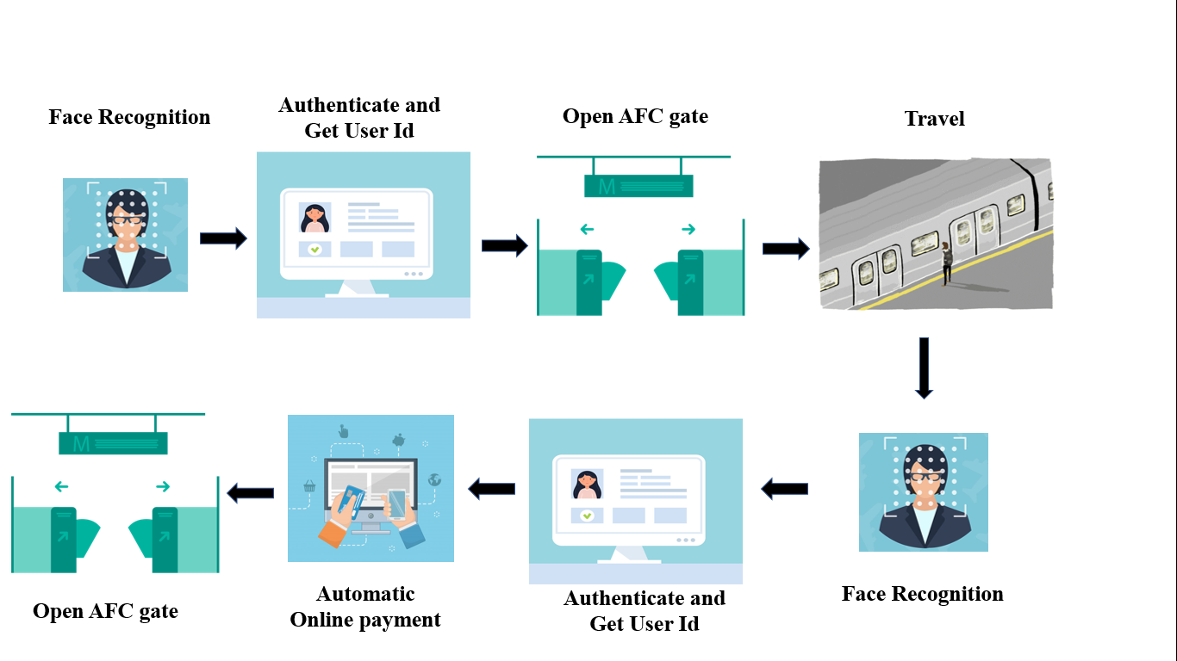
Contd…
Proposed System

Slide 7
Literature Survey

Slide 8
Summary of Literature Survey
Paper No. | Paper Name | Implementation | Limitation
1 | Zhang Rui, and Zheng Yan: “A Survey on Biometric Authentication: Toward Secure and Privacy - Preserving Identification”, IEEE, Digital Object Identifier 10.1109 /Access.2018.2889996, 2018. | Face Recognition as Biometric Authentication | No Real World solutions
2 | Varun Kaushik, and Suhas P: “Fool Proof Ticketing System for Public Transport”, Proceedings of the International Conference on Communication and Electronics Systems (ICCES 2018), IEEE Xplore Part Number: CFP18AWO-ART; ISBN:978-1-5386-4765-3,2018. | Better way of Ticketing system using Biometric Authentication | Inflexible implementation of fool proof
3 | Nataliya Boyko, Oleg Basystiuk, and Nataliya Shakhovska : “Performance Evaluation Comparison of Software for Face Recognition, based on Dlib and Opencv Library”, IEEE Second International Conference on Data Stream Mining & Processing, August 21-25,2018, Lviv, Ukraine. | Face Detection using Dlib Hog algorithm & Dataset | Different techniques of OpenCV and Dlib are not considered

Slide 9
Contd…
Paper No. | Paper Name | Implementation | Limitation
4 | Neel Ramakant Borkar, and Sonia Kuwelkar : “ Real-Time Implementation Of Face Recognition System”, Proceedings of the IEEE 2017 International Conference on Computing Methodologies and Communication(ICCMC),ISBN: 978-1-5090-4890-8/17, ©2017 IEEE. | Implementation of PCA and LDA algorithms for Face Recognition | Less Accuracy compared to CNN
5 | Radhika C Damale, and Prof. Bageshree V Phatak: “Face Recognition Based Attendance System Using Machine Learning Algorithms”, Proceedings of the second International Conference on Intelligent Computing and Control System (ICICCS 2018), IEEE Xplore Compliant Part Number: CFP18K74-ART; ISBN:978-1-5386-2842-3. | Methodology & Comparisons with respect to algorithms and classifiers | Hardware is not Implemented

Slide 10
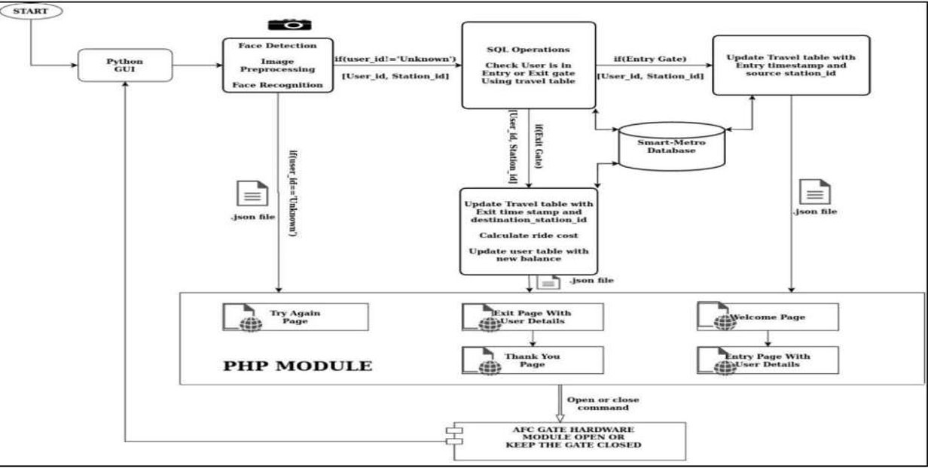
System Architecture

Slide 11
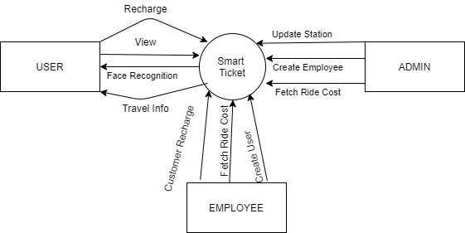
Data Flow Diagram
Level 0

Slide 12
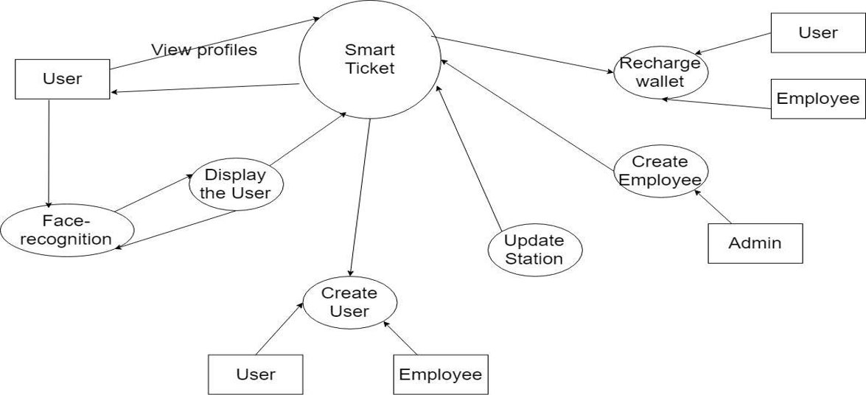
Level 1

Slide 13
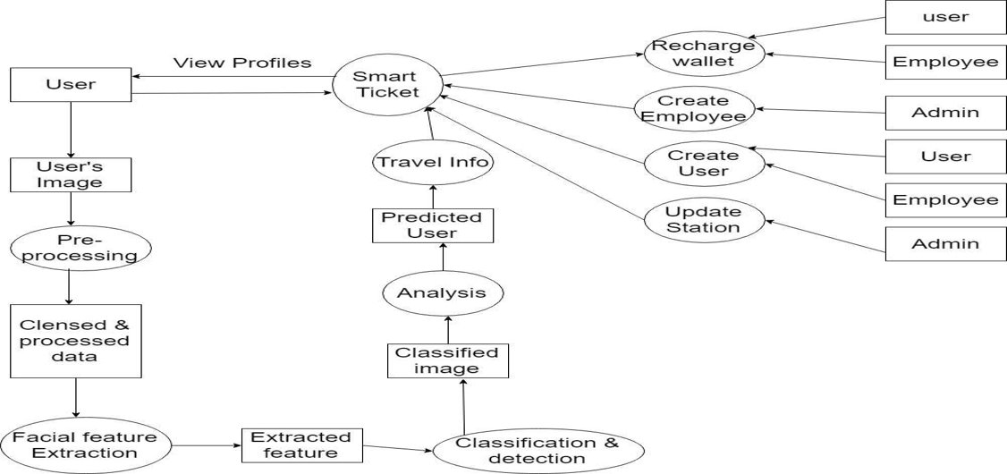
Level 2

Slide 14
Modules
Scikit-Learn
It is a Machine learning library to be used in python. It is a simple and efficient tool for data mining and data analysis. It is open source, commercially usable and reusable in various contexts. Scikit-Learn contains various supervised and unsupervised learning. algorithms for data pre-processing, feature extraction, feature selection, classification, regression, clustering, association rules, and visualization.
Matplotlib
It is a library that basically provides the 2D/3D plotting functions for python programming language in a similar manner as that of MATLAB. We can generate plots, histograms, power spectra, bar charts, scatterplots, boxplots etc. with just a few lines of code. It provides easy and quick way to visualize data from python. It gives a wide range of object - oriented API so as to combine plots into applications.

Slide 15
NumPy
It is an open source powerful package for implementing N-dimensional array object and large matrices of numeric data. It helps in doing scientific computation on the array objects. It contains various mathematical and numerical routines implemented in python to operate on the large arrays. It takes as its input the files in CSV (Comma Separated Values) format. If we use NumPy in python then it gives the functionality on the array objects which is similar to that of MATLAB. The reason being that they both are interpreted.
SciPy
Free and open source python library used for scientific and technical computing. The SciPy (Scientific Python) package incorporates a large collection of useful algorithms like minimization, Fourier transformation, regression, contains modules for optimization, linear algebra, interpolation, special functions, signal and image processing and other applied mathematical techniques common in science and engineering in addition to NumPy

Slide 16
• PHP
PHP is a server side scripting language that is embedded in HTML. It is used to manage dynamic content, databases, session tracking, even build entire e-commerce sites. It is integrated with a number of popular databases, including MySQL, PostgreSQL, Oracle, Sybase, Informix, and Microsoft SQL Server .Other Hardware based functional requirements that aid in the production ready model of the proposed project include.

Slide 17





Implementation

Slide 18
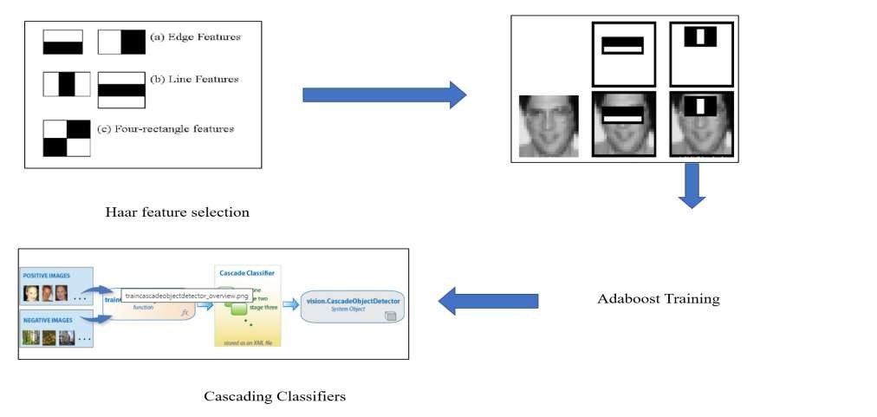
Algorithm
PCA & LDA
Testing the dataset and efficiency comparison
Step 1: Face Detection

Slide 19
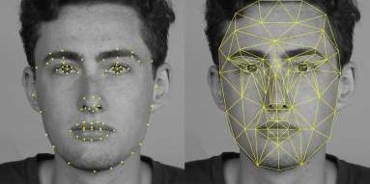
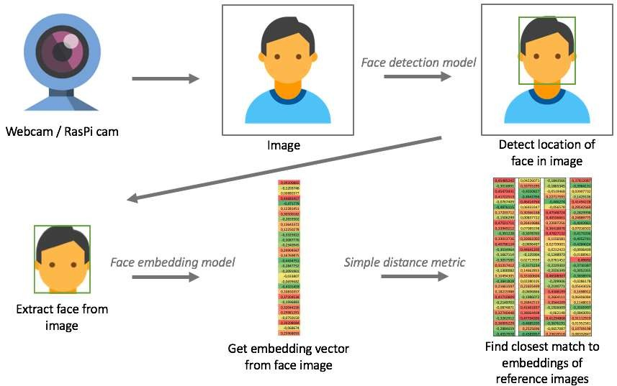
Contd..
Step 2 : Face Encoding

Slide 20
Contd..
Step 3 : Updating SQL Database.
Step 4 : Display the details of the user on the screen and open the AFC gate.

Slide 21
Contd..
Step 3 : Updating SQL Database.
Step 4 : Display the details of the user on the screen and open the AFC gate.

Slide 22
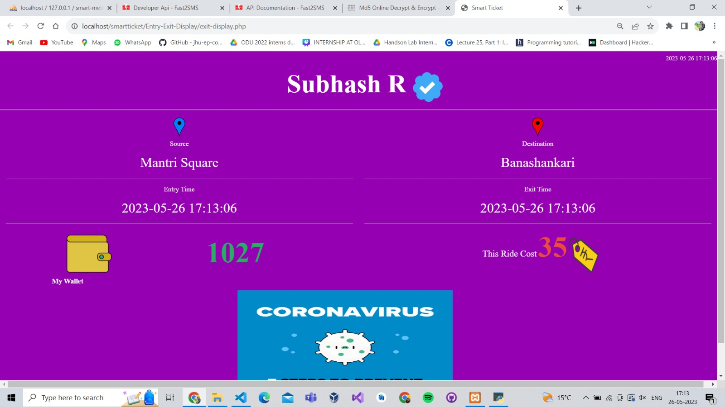
Result Analysis

Slide 23
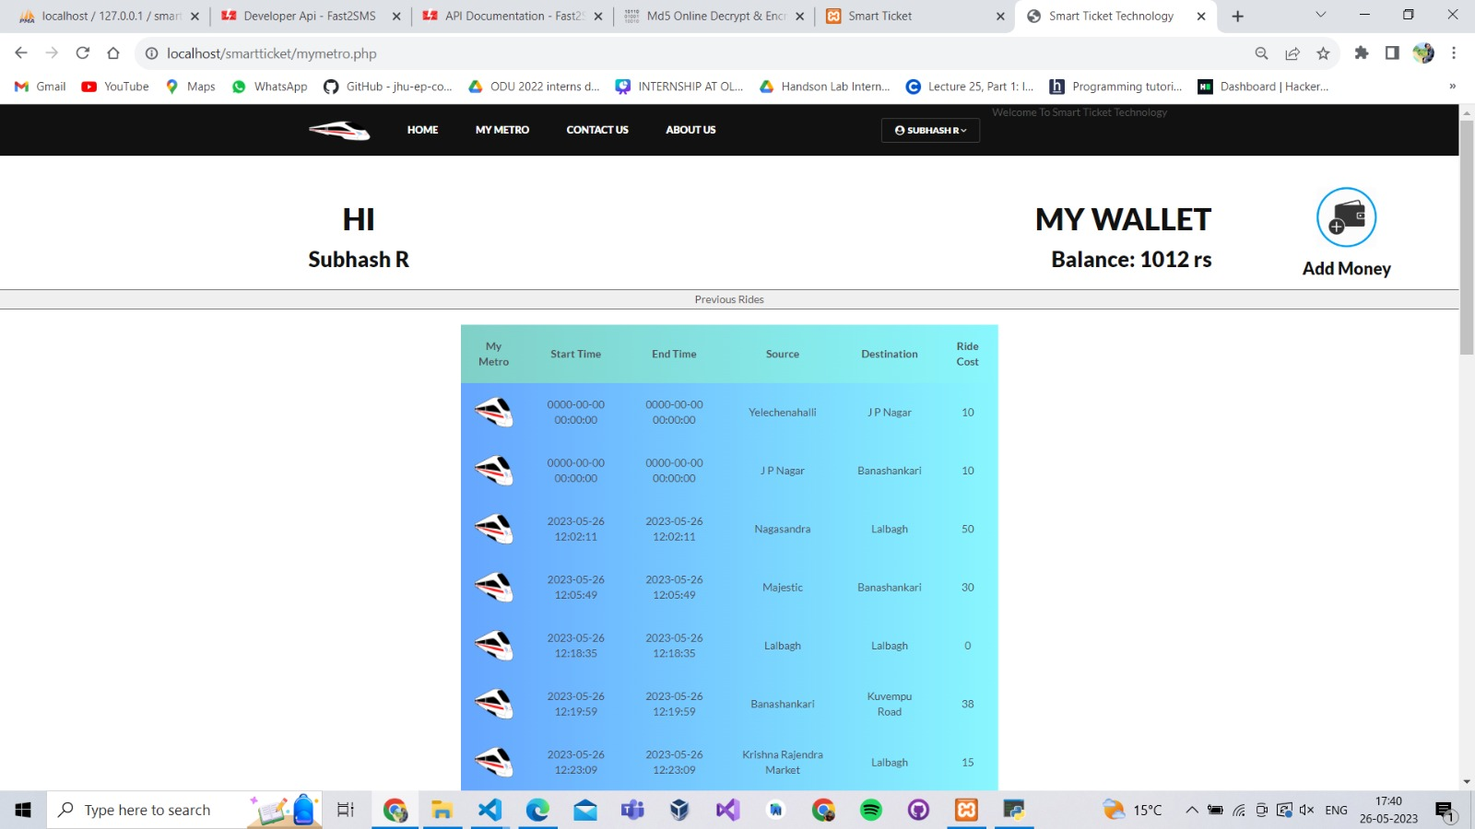
Contd..

Slide 24
CONCLUSION
Smart Ticket System for metro provides a solution for many key factors of public transportation such as User friendly , Fool proof , Secure Authentication , Data analytics for business optimization of public transportation.
The current project can be further enhanced by creating a better user-friendly GUI as application varies according to real time application. The model can be trained with images belonging to that particular locations in which it is used to improve the accuracy of prediction.

Slide 25
References
Zhang Rui, and Zheng Yan: “A Survey on Biometric Authentication: Toward Secure and Privacy - Preserving Identification”, IEEE, Digital Object Identifier 10.1109 /Access.2018.2889996, 2018.
Varun Kaushik, and Suhas P: “Fool Proof Ticketing System for Public Transport”, Proceedings of the International Conference on Communication and Electronics Systems (ICCES 2018), IEEE Xplore Part Number: CFP18AWO-ART; ISBN:978-1-5386-4765-3,2018.
Nataliya Boyko, Oleg Basystiuk, and Nataliya Shakhovska : “Performance Evaluation Comparison of Software for Face Recognition, based on Dlib and Opencv Library”, IEEE Second International Conference on Data Stream Mining & Processing, August 21-25,2018, Lviv, Ukraine.
Neel Ramakant Borkar, and Sonia Kuwelkar : “ Real-Time Implementation Of Face Recognition System”, Proceedings of the IEEE 2017 International Conference on Computing Methodologies and Communication(ICCMC),ISBN: 978-1-5090-4890-8/17, ©2017 IEEE.
Radhika C Damale, and Prof. Bageshree V Phatak: “Face Recognition Based Attendance System Using Machine Learning Algorithms”, Proceedings of the second International Conference on Intelligent Computing and Control System (ICICCS 2018), IEEE Xplore Compliant Part Number: CFP18K74-ART; ISBN:978-1-5386-2842-3.

Slide 26
THANK YOU

